Slide 1
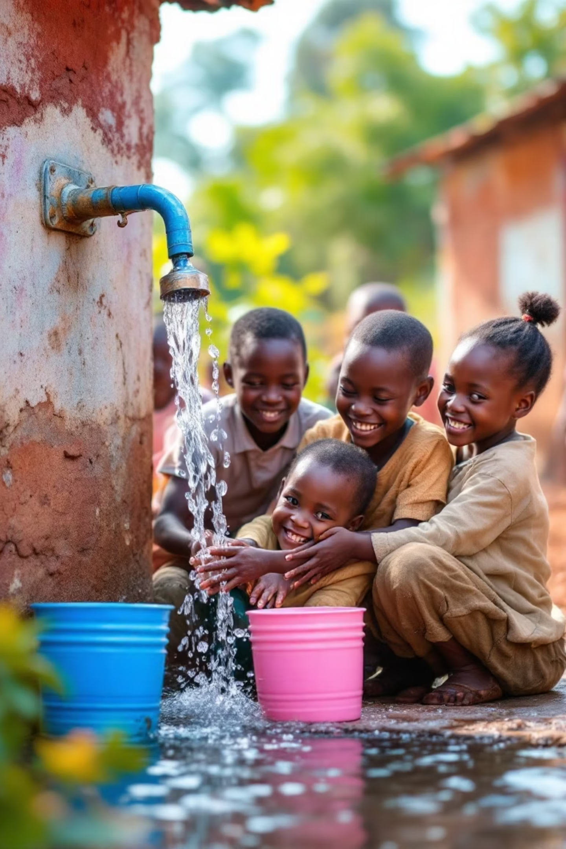
Safe Water Access and Child Mortality Project
Progress Report by Niyogitangaza Yvette, Byukusenge Josiane, Kakibibi Janviere, and Dusabemariya Solange

Slide 2
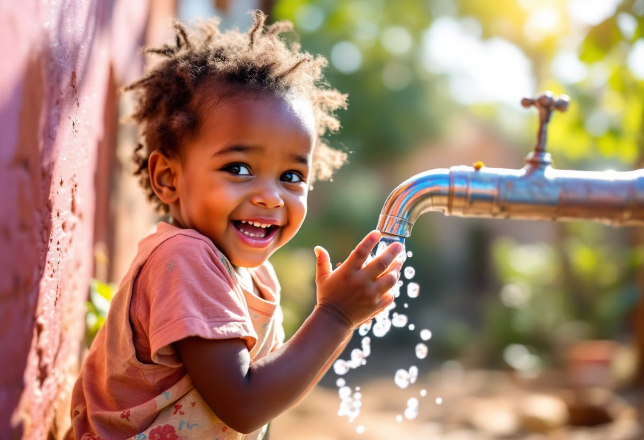
Introduction
Access to safe drinking water and adequate sanitation is a fundamental human right and a critical determinant of public health.
This project asks a simple but urgent question:
Can access to clean water and toilets help save children's lives?
Many people in poorer countries still live without safe water or sanitation.
As a result, preventable diseases like diarrhea continue to kill thousands of young children.
We’re using real data from WHO/UNICEF’S and the World Bank to find out where the need is greatest and how better access can make a life-saving difference.
Drawing from WHO/UNICEF Joint Monitoring Programme and World Bank data to assess how WASH infrastructure inequalities affect under-five mortality rates.

Slide 3
What Inspired This Project:
We asked ourselves:
What if data could help us to understand where the biggest problem are?
And can we use data to guide life saving decisions for the most vulnerable?
Here’s exactly the goal of our project:
Safe Water Access and child Mortality, a data driven study to uncover how lack of clean water and sanitation is affecting children’s survival in low- and middle-income countries,
Drawing from WHO/UNICEF Joint Monitoring Programme and World Bank data to assess how WASH infrastructure inequalities affect under-five mortality rates.

Slide 4
Project Objectives
1
2
Analyze Trends
Assess Correlation
Examine water and sanitation access patterns by country, region, and income group.
Evaluate the relationship between improved WASH services and under-five mortality rates.
3
4
Identify Vulnerable Areas
Support Policy
Pinpoint regions and countries where children face the highest risk.
Provide data-informed recommendations for water and sanitation infrastructure investment.

Slide 5

Research Questions
How have trends in access to improved water and sanitation services evolved since 2000?
What is the statistical relationship between WASH access and under-five mortality?
Which countries/regions are lagging behind and at greater risk?
How much progress has been made toward SDG 6 (universal access to water and sanitation)?

Slide 6
Data Sources
WHO/UNICEF JMP Dataset
Improved water/sanitation access
Facility types by country, region, income group
Urban/rural area breakdown
World Bank WDI Dataset
Under-five mortality rates
Timeframe: 2000–2023
GDP per capita
Focus: Low- and Middle-Income Countries (LMICs)
Population data

Slide 7

Current Progress
1
Data Acquisition
Downloaded JMP and WDI datasets from official platforms.
2
Data Cleaning
Standardized column names using Python, converted to lowercase, and fixed inconsistencies.
3
Data Merging
Merged datasets using country, region, income group, area type, and year as keys with full left join.

Slide 8
Cleaning and Preparing the Dataset
What We Did:
Removed any rows that were not actual data (like “year” inside rows)
Made sure the year column was stored as a number (not text)
Renamed columns to be clearer (e.g., under_5_mortality to under5_mortality_rates)
Checked for missing data and kept the most complete records
Replace where there is Nan to Unknown
Merging the Data for Full Insights
How We Combined the Data:
We merged the two datasets using : country code (iso3), country name and year for having one dataset that combined all data from all websites that we have
After Merging : We filtered the data to focus on low- and middle-income countries and we kept rural and urban breakdowns for deeper analysis
Saved the cleaned, merged file for use in dashboards and visuals

Slide 9
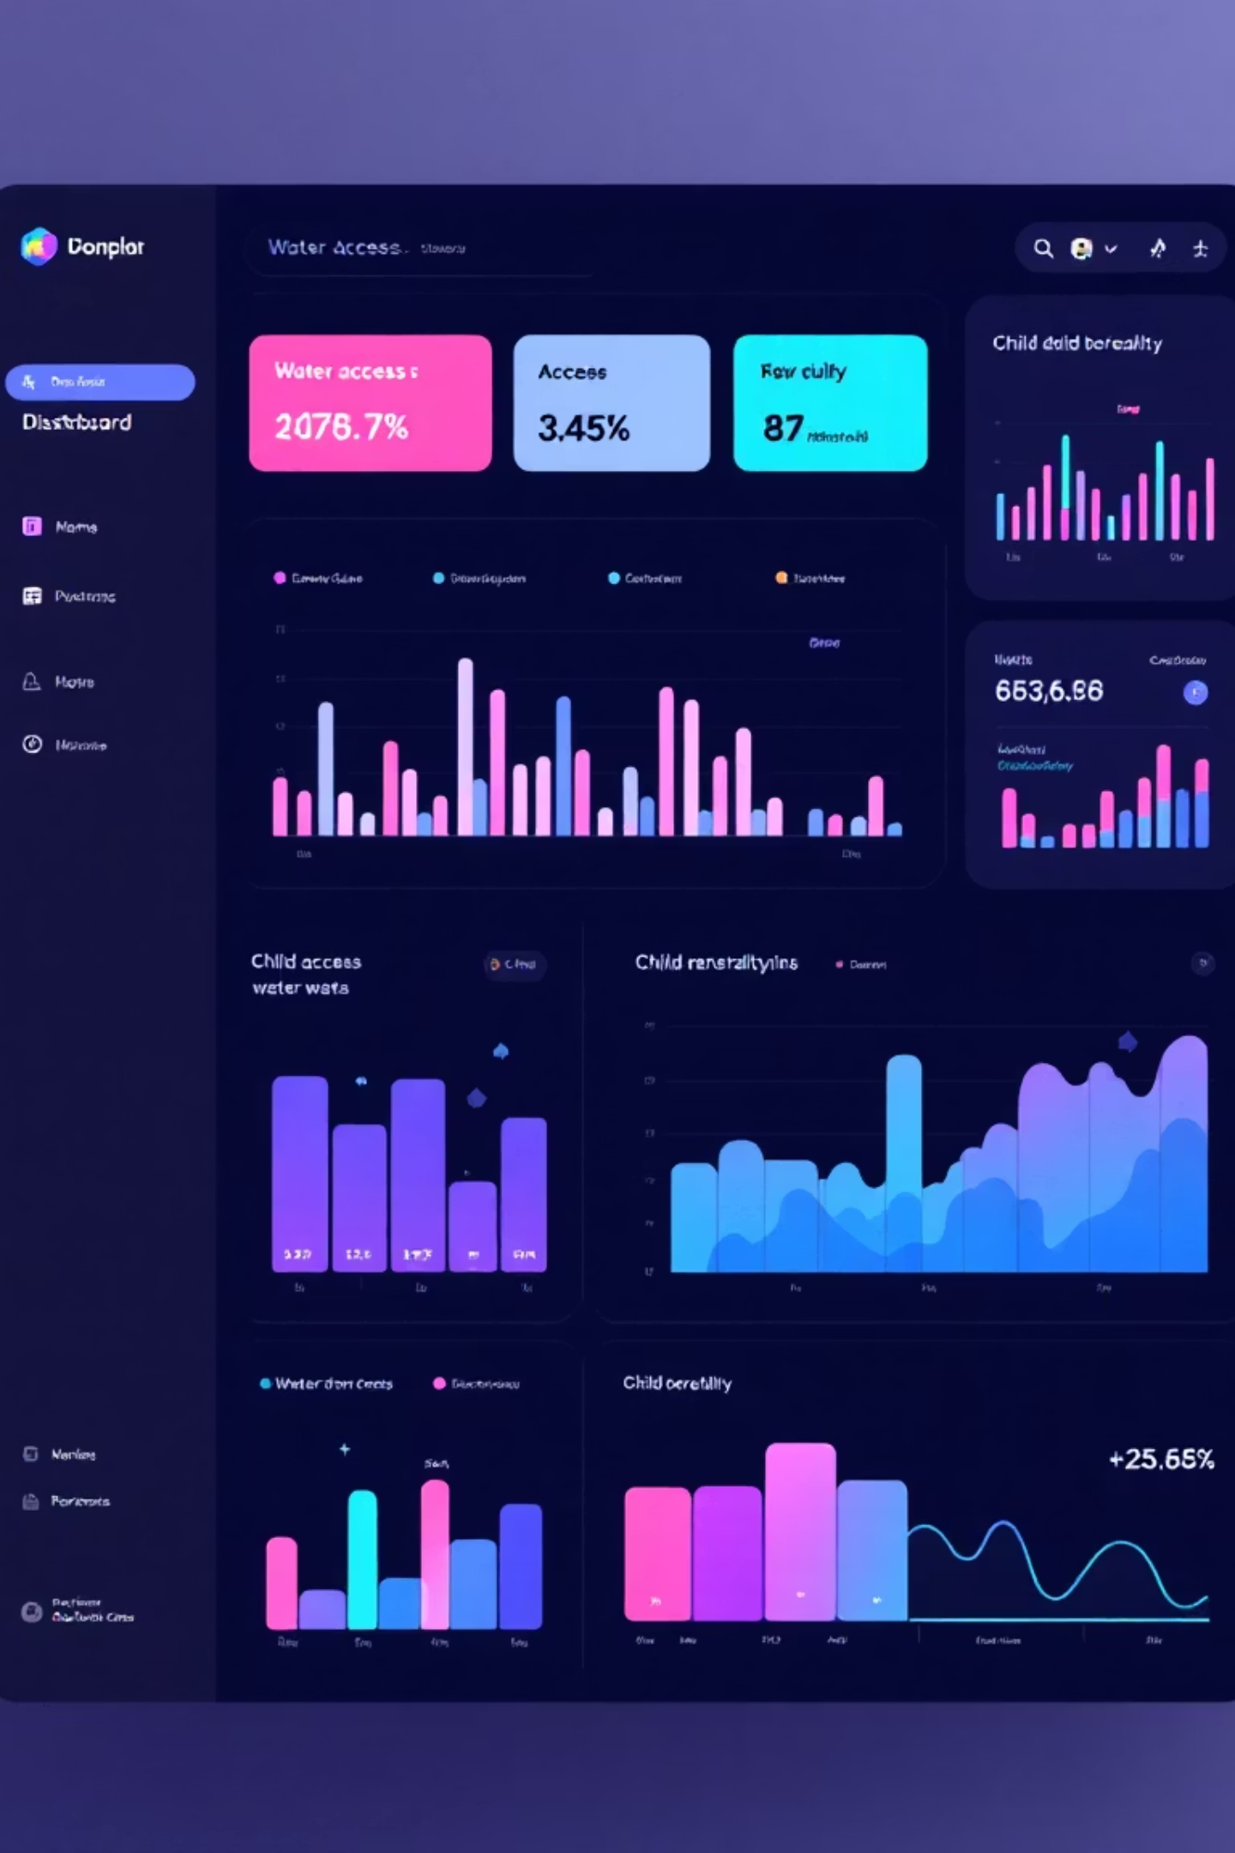
Weekly Goals & Deliverables
This Week's Goals
Deliverables
Finalize column standardization.
Cleaned, merged JMP and WDI dataset.
Perform summary statistics and trend analysis
Project progress report document
Begin vulnerability profiling by country/region
Summary statistics and correlation plots (in progress)
Draft interactive dashboard layout

Slide 10
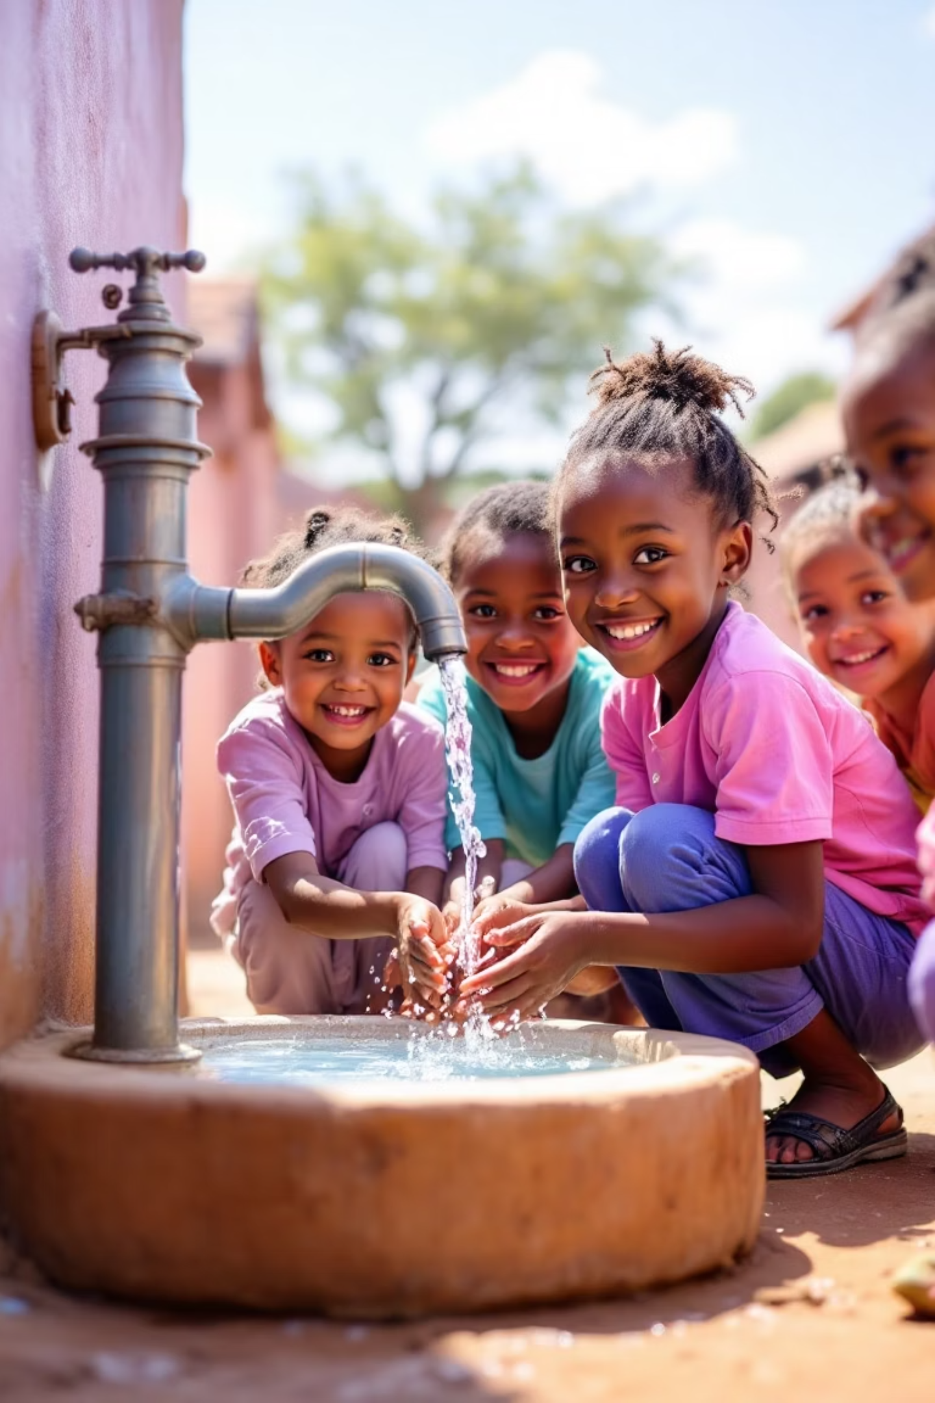
Potential Impact
This project will provide actionable insights into how improved access to WASH services can reduce child mortality.
By identifying critical gaps in infrastructure and public health services, this work will help governments and NGOs(National Government Organizations) prioritize investments that save lives and accelerate progress toward:
SDG 3(Sustainable Development Goal)
Good Health and Well-Being
SDG 6
Clean Water and Sanitation

